Slide 1
Problem Statement
Intensive Care Units (ICUs) are critical for the care of patients with severe and life-threatening illnesses or injuries. Continuous monitoring and timely intervention are essential to ensure patient safety and improve outcomes. However, the increasing demand for ICU services, coupled with a shortage of specialized healthcare professionals, poses significant challenges. TeleICU systems have emerged as a solution, enabling remote monitoring and management of ICU patients. While existing TeleICU systems primarily rely on traditional monitoring devices, there is a need for more advanced solutions that can provide comprehensive and real-time insights into patient conditions.

Slide 2
Unique Idea Brief (Solution)
1. High-Definition Video Monitoring: Utilize high-definition cameras to capture real-
time video of ICU patients, providing a comprehensive view of patient activities
and conditions.
2. Deep Learning Models: Develop and train deep learning models to analyze
video data and detect critical patient movements and anomalies, such as bed
exits, abnormal postures, and signs of distress.
3. Real-Time Alerts: Implement a real-time alert system to notify healthcare
professionals of detected anomalies, enabling timely interventions.
4. Seamless Integration: Ensure the system integrates seamlessly with existing
TeleICU infrastructure, including vital signs monitors and medical devices, to
provide a holistic view of patient conditions.
5. User-Friendly Interface: Design an intuitive user interface that displays real-time
data and alerts, facilitating quick and informed decision-making by healthcare
professionals.

Slide 3
Features Offered
1. High-Definition Video Monitoring
2. Advanced Deep Learning Models
3. Real-Time Alert System
4. Seamless Integration with Existing Systems
5. User-Friendly Interface
6. Secure Data Handling
7. Scalable Architecture
8. Comprehensive Analytics and Reporting
9. Enhanced Communication Tools
10. Continuous Learning and Improvement
11. Redundancy and Reliability

Slide 4
Processflow
1. Video Capture: - Install cameras in ICU rooms to capture video feeds of patients. - Ensure cameras are securely connected to the monitoring system.
2. Video Processing: - Feed video streams into the monitoring system. - Apply computer vision techniques to detect and track patients, objects, and activities. - Extract relevant features and data from video feeds.
3. Data Analysis: - Analyze extracted data using machine learning algorithms to detect anomalies and potential health issues. - Identify trends and patterns in patient behavior and vital signs.
4. Alert Generation: - Trigger alerts and notifications to healthcare professionals based on detected anomalies and potential health issues. - Prioritize alerts based on severity and urgency.
5. Remote Monitoring: - Allow remote access to video feeds and patient data for healthcare professionals. - Enable real-time monitoring and consultation.
6. Data Storage: - Store video feeds, extracted data, and analysis results securely. - Ensure data privacy and compliance with regulations.
7. System Maintenance: - Regularly update and maintain the monitoring system. - Ensure system reliability and accuracy.

Slide 5
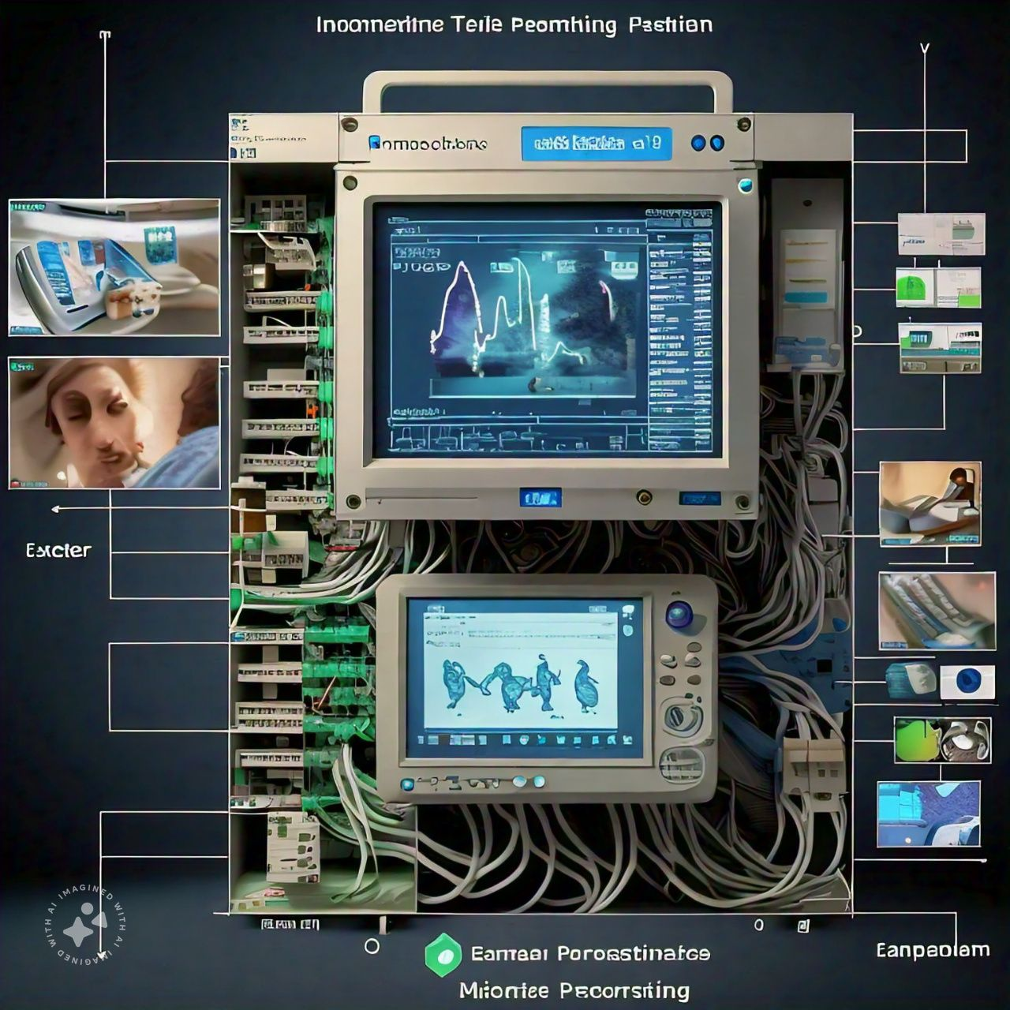
Architecture Diagram

Slide 6
Technologies used
1. Video Processing: OpenCV, FFmpeg.
2. Deep Learning:TensorFlow, PyTorch.
3. Hardware:High-Definition Cameras,Medical Sensors
4. Data Transmission and Networking:Secure Sockets Layer (SSL), Wi-Fi and Ethernet
5. Real-Time Processing:GStreamer
6. Data Storage and Management:SQL Databases
7. Cloud Services: Amazon Web Services (AWS)
8. User Interface and Interaction: React.js
9. Security: OAuth2.0
10. Communication: WebRTC
11. Analytics and Reporting: Apache Kafka

Slide 7
Team members and contribution:
Team Leader: Rakshit.V.D
Members: 1.Niranjan Kadechur
2.Siddaling.G.M
This project is obediently completed with the contribution of team members ,but also
there are few cases where individuals worked hard for a particular work such as
1.Rakshit have worked on the resource related to coding and algorithms and to present
the working of project.
2. Niranjan and Siddaling worked on the report and studied the whole project given a
best presentation in report.

Slide 8
Conclusion
• The development of an innovative TeleICU monitoring system integrating video
processing and deep learning technologies represents a significant advancement in
remote patient care. This system addresses critical challenges faced by traditional
TeleICU systems, such as limited monitoring capabilities, resource constraints, data
overload, and integration complexity.
• Through the implementation of this innovative TeleICU monitoring system, we aim to
revolutionize remote patient monitoring, reduce the workload on healthcare
professionals, and ultimately enhance the quality of care provided to critically ill patients.

